Slide 1
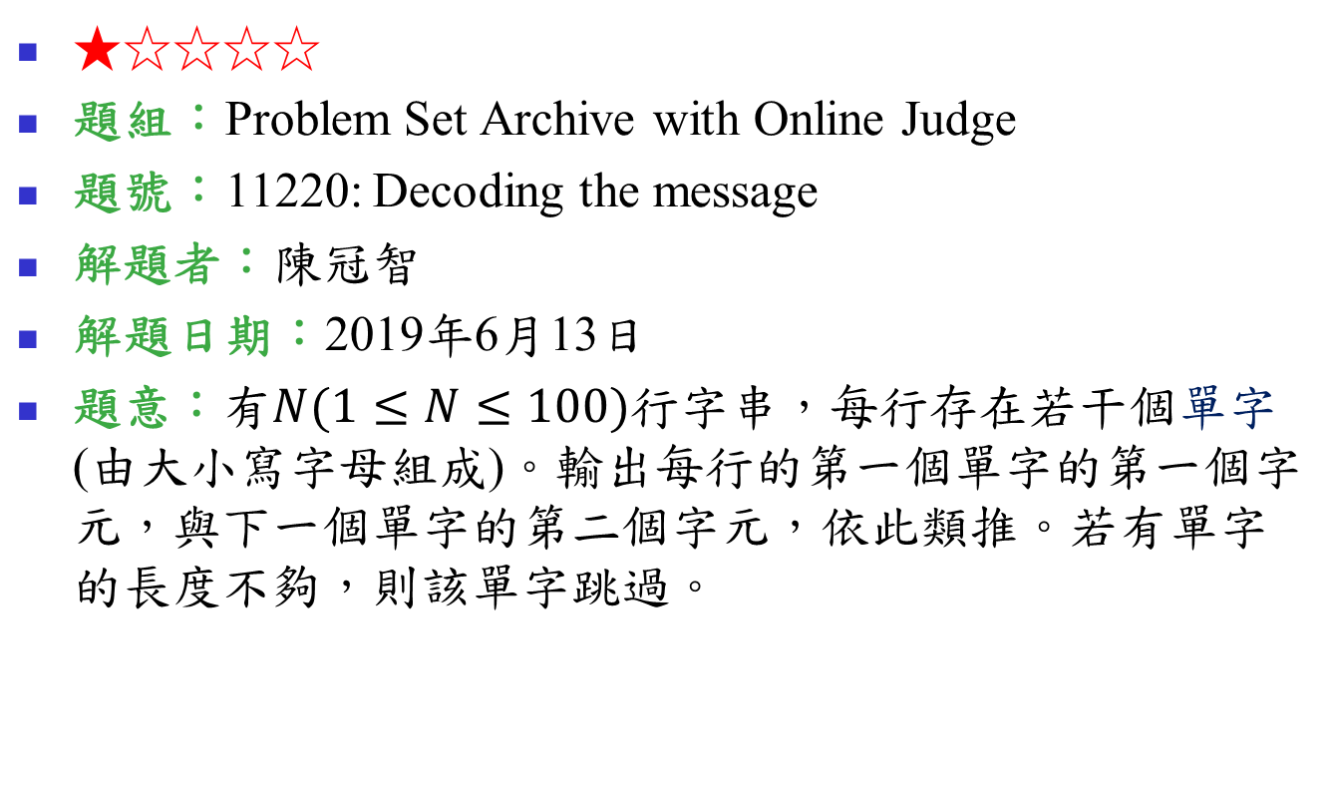
11220: Decoding the message
★☆☆☆☆
題組：Problem Set Archive with Online Judge
題號：11220: Decoding the message
解題者：陳冠智
解題日期：2019年6月13日
題意：有$N(1≤N≤100)$行字串，每行存在若干個單字(由大小寫字母組成)。輸出每行的第一個單字的第一個字元，與下一個單字的第二個字元，依此類推。若有單字的長度不夠，則該單字跳過。

Slide 2
題意範例：
Input
Hey good lawyer
as I previously previewed
yam does a soup
每行獨立觀察:
Hey good lawyer
as I previously previewed
yam does a soup
1 2 3
1 2 3
Output
How
are
you
長度< 2，跳過
1 2 3
長度< 3，跳過

Slide 3
解法：
1. 將每行輸入切成以單字為單位之token
(參見C/C++ library – strtok)
2. 用變數紀錄輸出的單字位置
3. 將token依序shift，依規則輸出
char *s = “word word word";
char *token;
token = strtok(s, " ");

Slide 4
解法範例：
token:
as I previously previewed
p=1, output: a
as I previously previewed

Slide 5
解法範例：
token:
as I previously previewed
p=1, output: a
as I previously previewed
p=2, output: a
as I previously previewed

Slide 6
解法範例：
token:
as I previously previewed
p=1, output: a
as I previously previewed
p=2, output: a
as I previously previewed
p=2, output: ar
as I previously previewed

Slide 7
解法範例：
token:
as I previously previewed
p=1, output: a
as I previously previewed
p=2, output: a
as I previously previewed
p=2, output: ar
as I previously previewed
p=3, output: are
as I previously previewed

