Slide 1
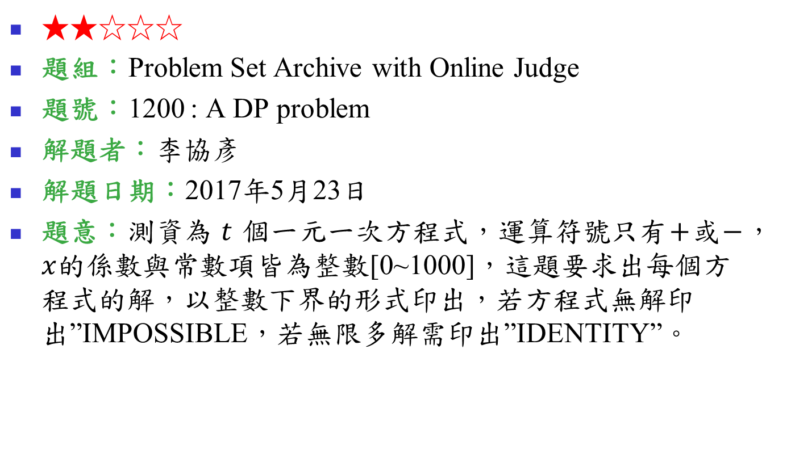
1200: A DP problem
★★☆☆☆
題組：Problem Set Archive with Online Judge
題號：1200 : A DP problem
解題者：李協彥
解題日期：2017年5月23日
題意：測資為 $t$ 個一元一次方程式，運算符號只有$+$或$−$，$x$的係數與常數項皆為整數[0~1000]，這題要求出每個方程式的解，以整數下界的形式印出，若方程式無解印出”IMPOSSIBLE，若無限多解需印出”IDENTITY”。

Slide 2
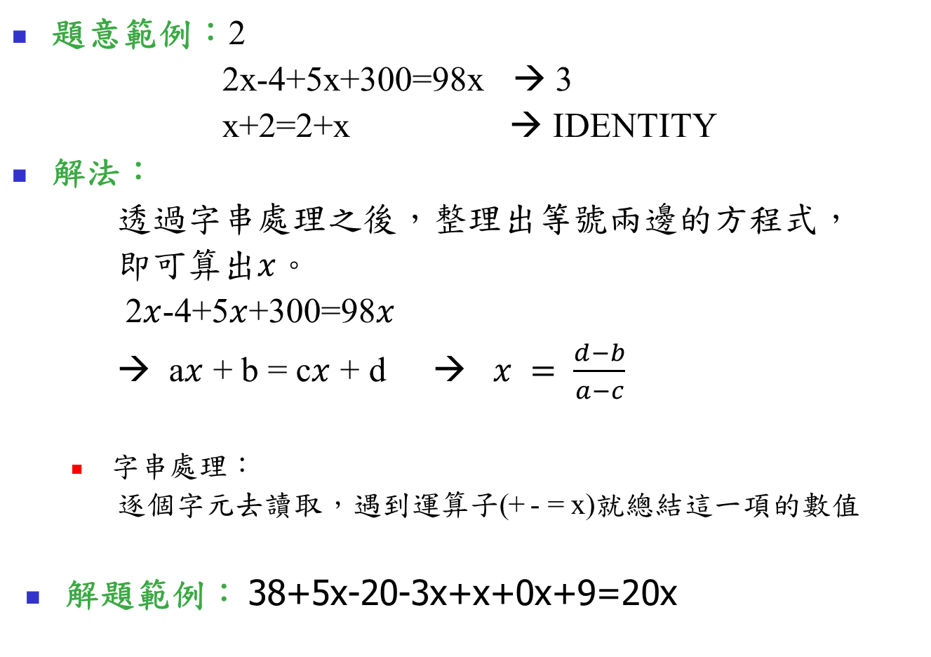
題意範例：2
2x-4+5x+300=98x → 3
x+2=2+x → IDENTITY
解法：
透過字串處理之後，整理出等號兩邊的方程式，
即可算出$x$。
2$x$-4+5$x$+300=98$x$
→ a$x$ + b = c$x$ + d → $x = \frac{d−b}{a−c}$
  字串處理：
  逐個字元去讀取，遇到運算子(+ - = x)就總結這一項的數值
解題範例： 38+5x-20-3x+x+0x+9=20x

Slide 3
38+5x-20-3x+x+0x+9=20x
Positive | +
Value | 0
length | 0
ax + b = cx + d
a | b | c | d
0 | 0 | 0 | 0

Slide 4
38+5x-20-3x+x+0x+9=20x
Positive | +
Value | 3
length | 1
ax + b = cx + d
a | b | c | d
0 | 0 | 0 | 0

Slide 5
38+5x-20-3x+x+0x+9=20x
Positive | +
Value | 38
length | 2
ax + b = cx + d
a | b | c | d
0 | 0 | 0 | 0

Slide 6
38+5x-20-3x+x+0x+9=20x
Positive | +
Value | 38
length | 2
ax + b = cx + d
a | b | c | d
0 | 0 | 0 | 0

Slide 7
38+5x-20-3x+x+0x+9=20x
Positive | +
Value | 38
length | 2
ax + b = cx + d
a | b | c | d
0 | 38 | 0 | 0

Slide 8
38+5x-20-3x+x+0x+9=20x
Positive | +
Value | 0
length | 0
ax + b = cx + d
a | b | c | d
0 | 38 | 0 | 0

Slide 9
38+5x-20-3x+x+0x+9=20x
Positive | +
Value | 5
length | 1
ax + b = cx + d
a | b | c | d
0 | 38 | 0 | 0

Slide 10
38+5x-20-3x+x+0x+9=20x
Positive | +
Value | 5
length | 1
ax + b = cx + d
a | b | c | d
0 | 38 | 0 | 0

Slide 11
38+5x-20-3x+x+0x+9=20x
Positive | +
Value | 5
length | 1
ax + b = cx + d
a | b | c | d
5 | 38 | 0 | 0

Slide 12
38+5x-20-3x+x+0x+9=20x
Positive | -
Value | 0
length | 0
ax + b = cx + d
a | b | c | d
5 | 38 | 0 | 0

Slide 13
38+5x-20-3x+x+0x+9=20x
Positive | -
Value | 20
length | 2
ax + b = cx + d
a | b | c | d
5 | 18 | 0 | 0
ax + b = cx + d
a | b | c | d
5 | 38 | 0 | 0

Slide 14
38+5x-20-3x+x+0x+9=20x
Positive | +
Value | 0
length | 0
Special case → value=1
ax + b = cx + d
a | b | c | d
2 | 18 | 0 | 0
ax + b = cx + d
a | b | c | d
3 | 18 | 0 | 0

Slide 15
38+5x-20-3x+x+0x+9=20x
Positive | +
Value | 0
length | 1
ax + b = cx + d
a | b | c | d
3 | 18 | 0 | 0

Slide 16
38+5x-20-3x+x+0x+9=20x
Positive | +
Value | 9
length | 1
ax + b = cx + d
a | b | c | d
3 | 18 | 0 | 0

Slide 17
38+5x-20-3x+x+0x+9=20x
Positive | +
Value | 9
length | 1
ax + b = cx + d
a | b | c | d
3 | 27 | 0 | 0

Slide 18
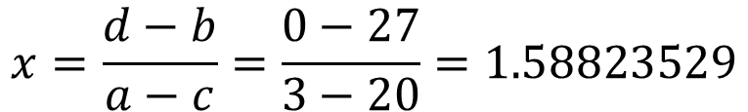

ax + b = cx + d
a | b | c | d
3 | 27 | 20 | 0
$$x=\frac{d−b}{a−c}=\frac{0−27}{3−20}=1.58823529$$
$$\left\lfloor 1.58823529\right\rfloor =1$$

Slide 19
ax + b = cx + d
a | b | c | d
3 | 27 | 20 | 0
$$x=\frac{d−b}{a−c}=\frac{0−27}{3−20}=1.58823529$$
$$\left\lfloor 1.58823529\right\rfloor =1$$
a == c and b == d → IDENTITY
a == c and b != d → IMPOSSIBLE

Slide 20
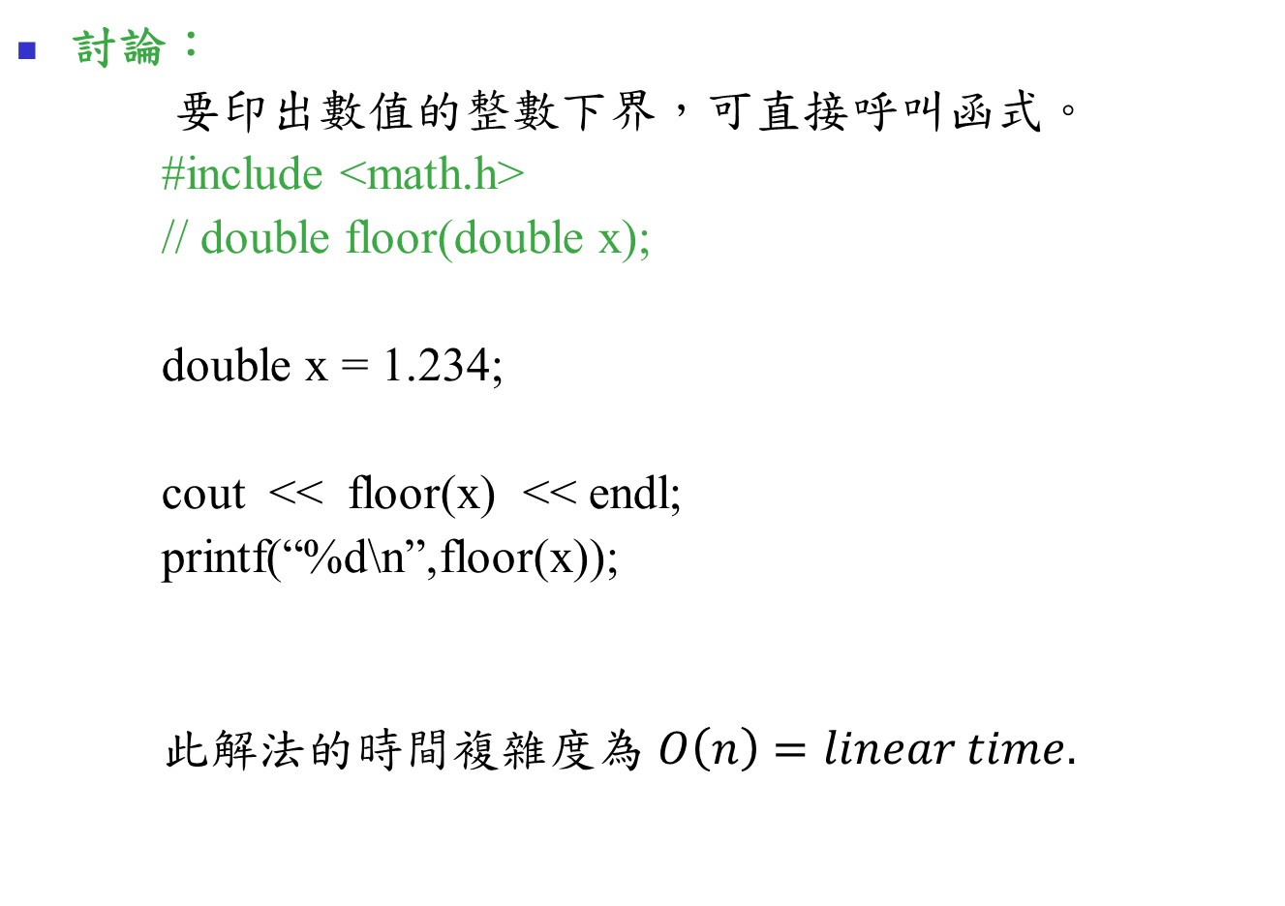
討論：
要印出數值的整數下界，可直接呼叫函式。
#include <math.h>
// double floor(double x);
double x = 1.234;
cout << floor(x) << endl;
printf(“%d\n”,floor(x));
此解法的時間複雜度為 $O\left(n\right)=linear time.$

